Slide 1
Cloning Club
Introducing a deletion into a DNA sequence
-Khushbu
-Karthik
-Nebeyu

Slide 2
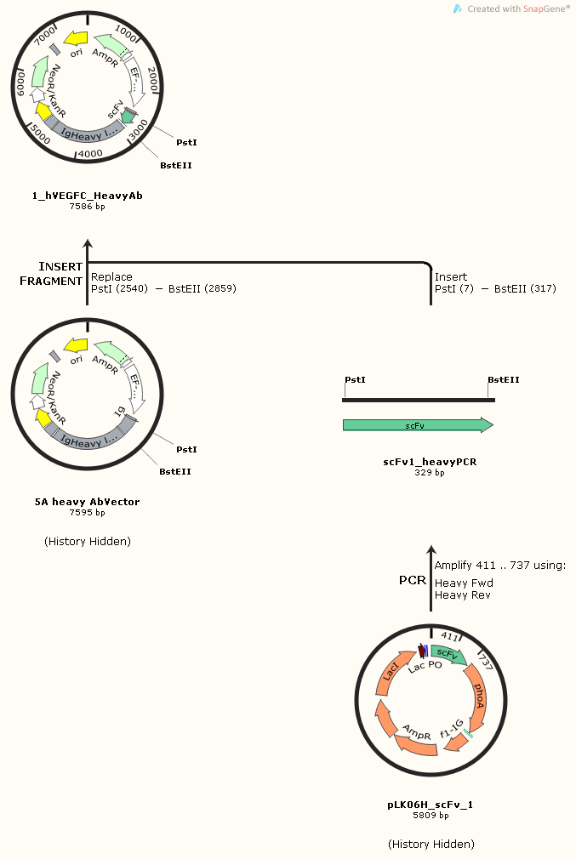
Cloning Plan

Slide 3
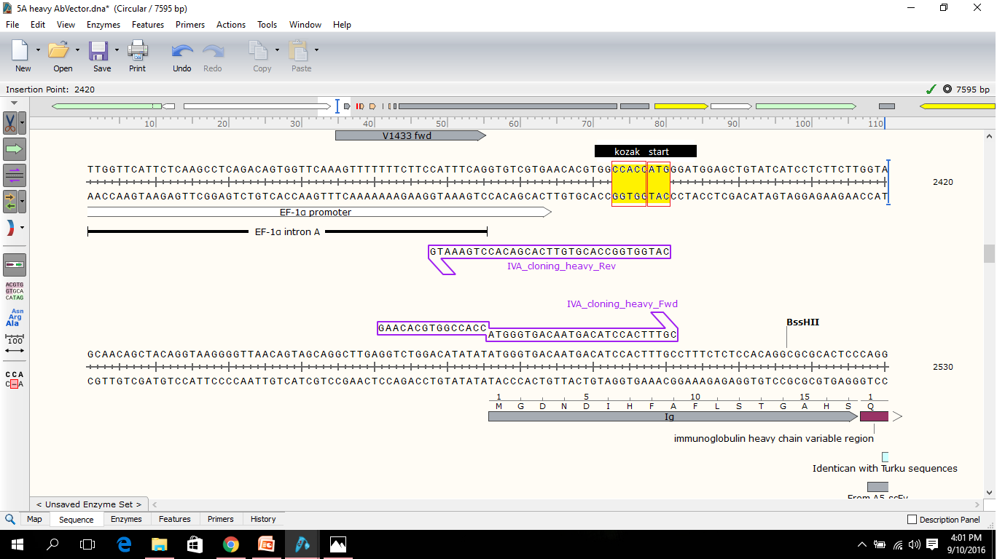
Cloning Problem

Slide 4
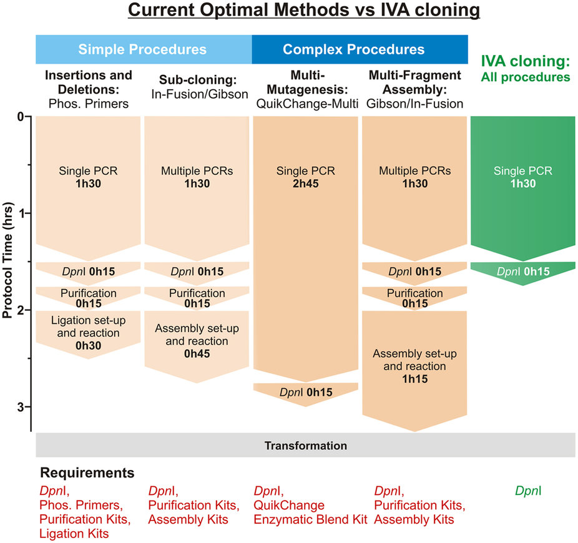
Complete system to perform multiple cloning procedure.
recA- independent recombination pathway (E.coli strains)
No need for enzymatic assembly
Cloning procedure in “1” tube
Single step PCR
Setup to Transformation (<2 hrs)

Slide 5
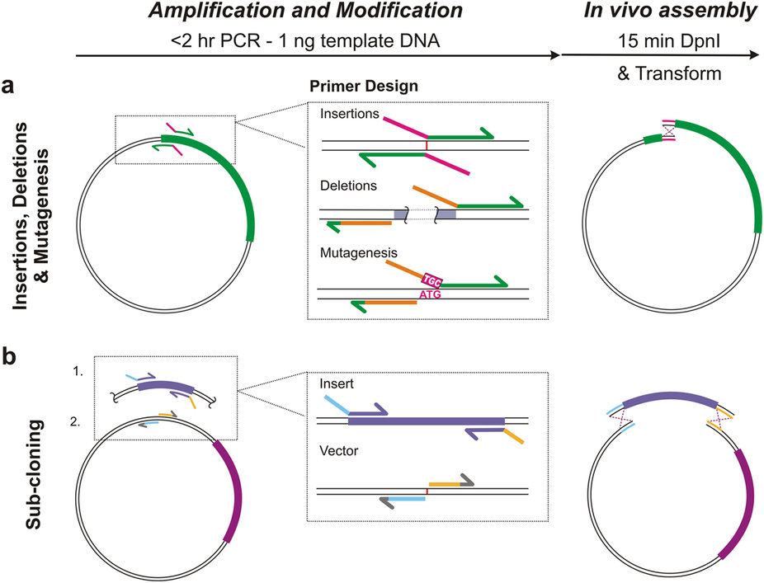
IVA cloning overview and primer design optimization
Single PCR reaction
Homologous linear ends
Dpnl digestion and transformation
Multi site modification
Multi fragment assembly
Plasmid library construction
Insertions, Fw/Rw primer
Acts as homologous region
Deletions, overlap added to
any one primer homologous
to other primer with primers
Straddling the undesired
Region (grey)
Mutagenesis, Inversely
Amplifying outside the
Undesired codon (ATG) with
Replacement Coded in
FW primer (TGC)

Slide 7
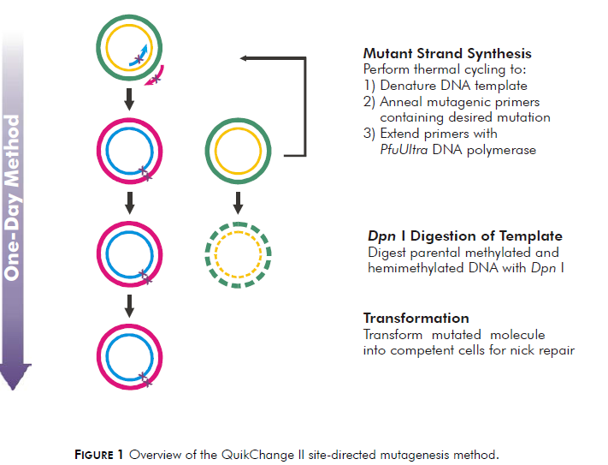

Slide 8
Important points to consider
Both primers should contain the desired mutation
The E.coli strain must be dam+
The desired mutation should be in the middle of the primers with ~10 -15.
The primers should be between 25 and 45 bases in length
It is recommended to use the formula than primer design software for calculating. Tm should be ≥78°C.

Slide 9
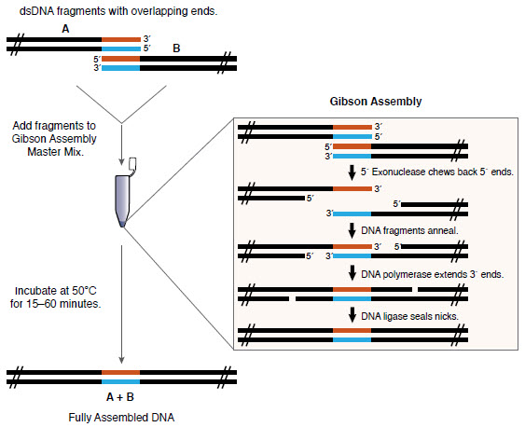
Gibson Assembly

Slide 10
Practical Part
Steps:
Design primer.
Perform PCR.
Digest with DpnI.
Transform into XL- gold ultracompetent cells and also compare with self-made competent cells.
Check the colonies for deletion of unwanted fragment.
Ready vector???----proceed to the cloning plan.

